Slide 1
Naïve Bayes

Slide 2
Generative vs. Discriminative Classifiers
Training classifiers involves estimating f: X → Y, or P(Y|X)
Discriminative classifiers (also called ‘informative’ by Rubinstein&Hastie):
Assume some functional form for P(Y|X)
Estimate parameters of P(Y|X) directly from training data
Tumor size
Notes:
Last time we talked about discriminative learning algorithms like logistic regression.
Today, we will talk about generative learning algorithms like easy to implement, quick to run and may work better on a smaller dataset.
Ex. logistic regression is trying to find a straight line to separate the two classes

Slide 3
Generative vs. Discriminative Classifiers
Training classifiers involves estimating f: X → Y, or P(Y|X)
Generative classifiers
Assume some functional form for P(X|Y), P(X)
Estimate parameters of P(X|Y), P(X) directly from training data
Model predictions based on P(Y|X= x_{i})
Tumor size
Notes:
- Generative learning algorithms on the other hand, instead of just finding a line that separates the two pieces of data.
- Just focus on the benign tumors and builds a model for what benign tumors look like
- Then also build a model of what malignant tumors look like
- Then given a new datapoint, we will lo ok at the two models and decide if the new datapoint is likely to be benign or malignant.

Slide 4
Discriminative vs Generative Algorithms
Given a space of input X, and a set of labels y {0,1}, learn p(y|x).
Discriminative Algorithms
Try to learn p(y|x) directly from the inputs X to the labels (ex. logistic regression)
EX. Given a dataset in which we want to train an algorithm to find a straight line that separates the two labels (for instance).
Given a new input, it checks which side of the decision boundary this input falls in and makes the prediction.
Generative Algorithms
Try to model p(x|y) and p(y)

Slide 5
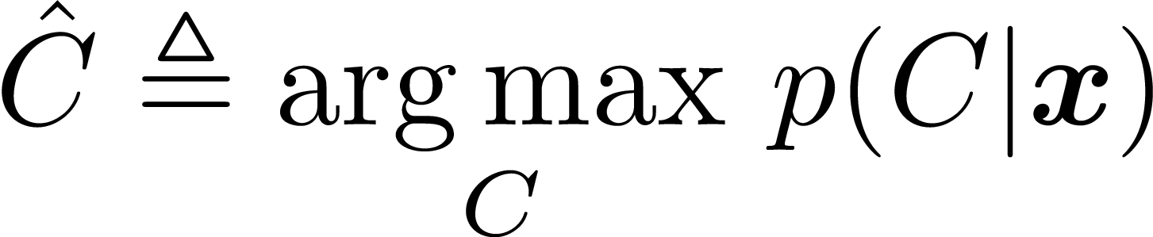
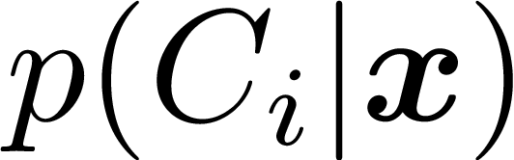
Maximum A Posteriori (MAP) Classifier
Given the data feature vector x, we would like to find the class with the largest probability:
To accomplish this, we iterate through all possible classes C₁, C₂, …., C_{K} and evaluate the quantity , and pick the class that has the largest probability.

Slide 6
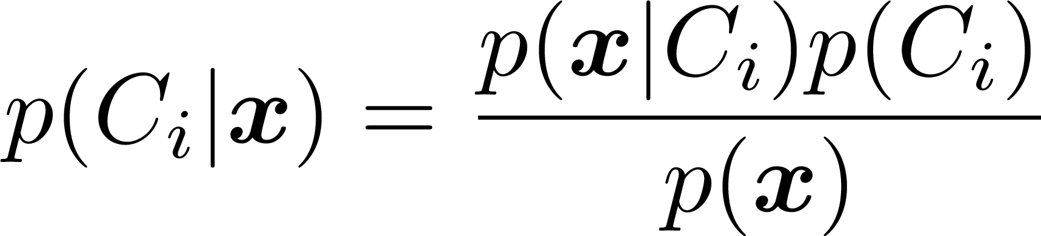
MAP Classifier: Bayes Rule
How do we compute ? Apply Bayes’ Rule!
Applying Bayes’ rule to , we obtain:
likelihood
prior
$$p\left(A | B\right)p\left(B\right)=p\left(B | A\right)p\left(A\right) \begin{matrix} & \end{matrix}⇒p\left(A | B\right)=\frac{p\left(B | A\right)p(A)}{p(B)}$$
evidence

Slide 7
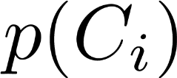
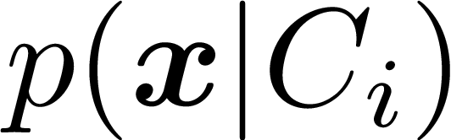
MAP Classifier: Bayes Rule (2)
is called the prior probability of a class
is called the likelihood of the data (what is the probability of observing x if the class was C_{i})
p(x) is the probability of seeing the data so its simply a normalizing factor (applies to all C_{i}), so doesn’t affect which C_{i} attains MAP.
Notes:
For p(Ci) talk about how if you are trying to determine a disease, and you know it only occurs at a rate of 1/1000, then p(disease) = 1/1000, while p(no disease) = 999/1000.
Or p(male) vs. p(female) if you have equal number of men and women in your test set.

Slide 8
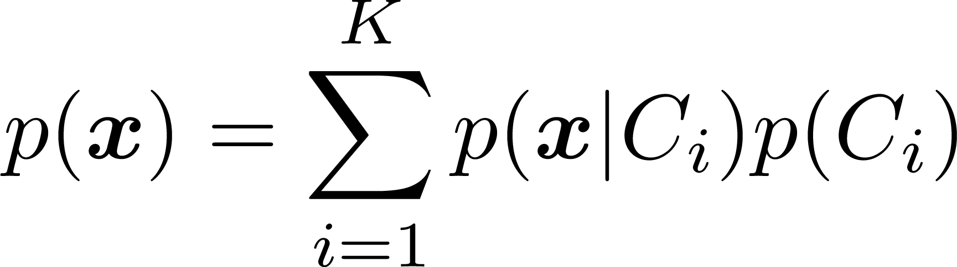
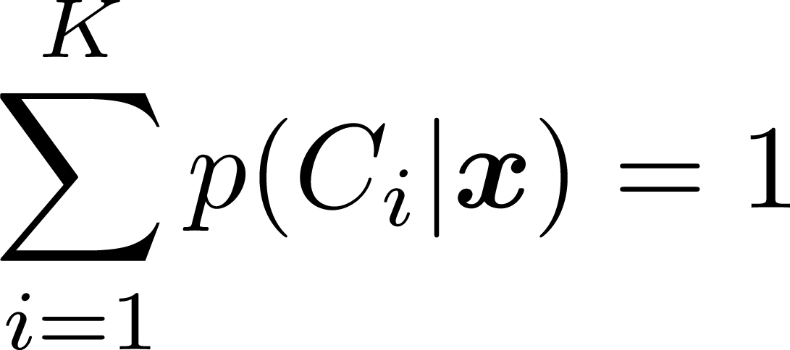
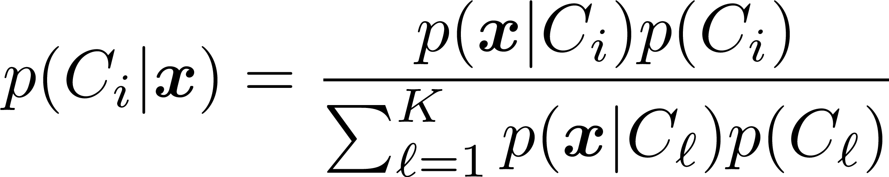
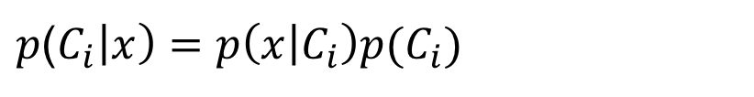
MAP Classifier: Bayes Rule (3)
To compute the normalizing factor, we use:
So that
Hence,
But really, we don’t need to calculate the denominator p(x), so we can simply write it as
$p$($C_{i}\left|x\right)=p\left(x | C_{i}\right)p(C_{i})$

Slide 9

MAP Classifier: Bayes Rule (4)
Usually, the likelihood is difficult to compute because it is N-dimensional (length of feature vector).
This is because the distribution considers correlations between the features when computing the likelihood.
We can write equivalently as:
which makes the dependence on individual features explicit.

Slide 10
Naive Bayes Classifier
So, P(c) is easy to compute…
What about P(x₁, x₂, … , x_{n} | c) ?
The probability of the class given the features.
This is hard to compute given that there are many features.
O( |X|^{n}*|C|) parameters
Also, its hard to generate this unless we have a large training dataset.

Slide 11
Naive Bayes Classifier
P(x₁, x₂, … , x_{n} | c)
Bag of Words assumption : order of the words don’t matter
Conditional independence: Assume the feature probability P(x_{i}|c) are independent given the class c.
Obviously this assumption may not always be true, but this simplification allows us to solve the more easily.

Slide 12
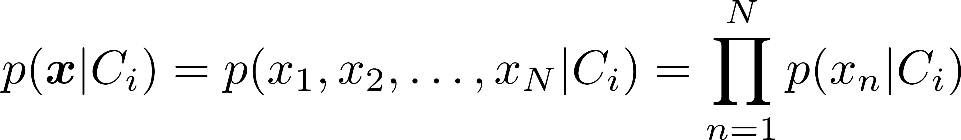
Naïve Bayes Classifier: Independence Assumption
The Naïve Bayes classifier introduces one major assumption regarding the features: independence
That is, the Naïve Bayes classifier assumes:
That is, the complicated likelihood can now be factored into a product of N 1-dimensional likelihoods, which are easy to compute.
It is good to note that independence implies that the features are not correlated (but generally not the other way around---so independence is a stronger assumption).
Notes:
Independence => uncorrelated
Uncorrelated =/> independent (except when the JOINT distribution of the features is Gaussian, in which case they do imply one another).

Slide 13
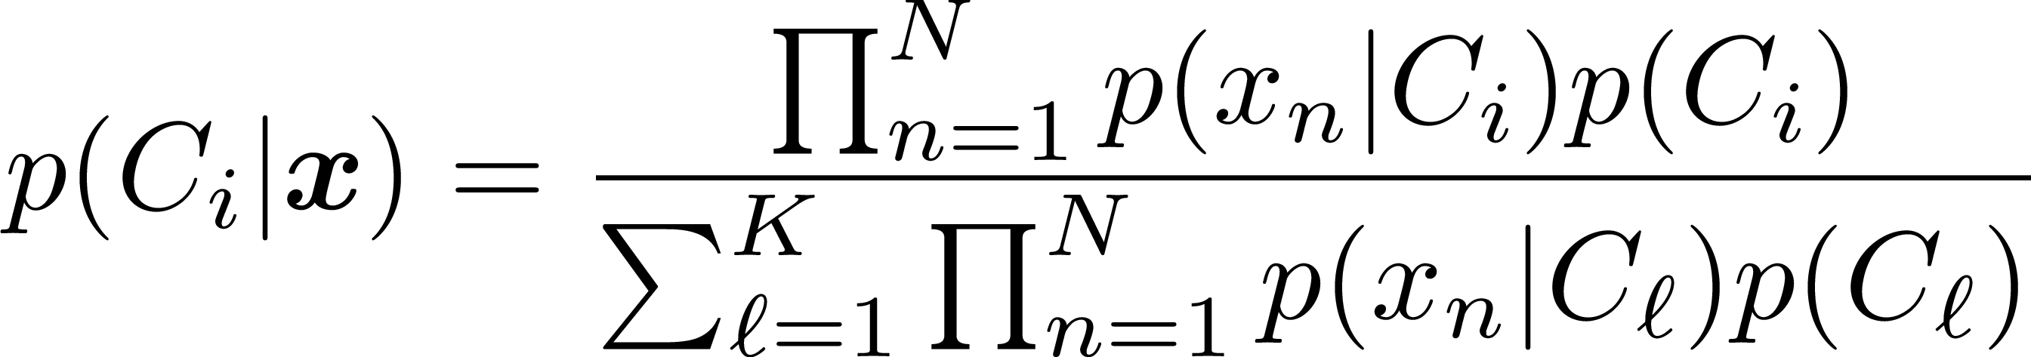
Naïve Bayes Classifier
With the independence assumption, the MAP classifier (now called the Naïve Bayes Classifier) can be written as:
It turns out that the Naïve Bayes classifier works very well on empirical datasets even if the independence assumption doesn’t actually hold.

Slide 14
Naïve Bayes Classifier
What happens our training example does not have an instance that is present in the test data?
To eliminate zeros, we use add-one or Laplace smoothing, which simply adds one to each count.
Now, let us see Spark documentation: http://spark.apache.org/docs/latest/mllib-naive-bayes.html

Slide 15
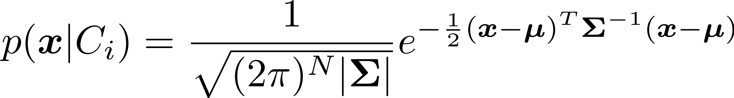
Example
Assume that the feature vectors are jointly-Gaussian distributed given the class, then we have that the likelihood is given by:
Show that when the features are Jointly-Gaussian distributed, then assuming that the features are uncorrelated implies they are independent. I.e., the MAP classifier with Jointly-Gaussian features vectors that are uncorrelated leads to the Naïve Bayes Classier and vice-versa.
Notes:
Hint: uncorrelated implies that the covariance matrix is diagonal (not neccessarity scaled identity, but at least diagonal). Show that p(x|C_i) can be written as p(x_1|C_i)p(x_2|C_i)….p(x_N|C_i) when Sigma is diagonal where p(x_n|C_i) is the standard 1-D Gaussian distribution 1/sqrt(2pi sigma_n^2) e^(-1/(2sigma_n^2) (x_n-mu_n)^2)

Slide 16
EXAMPLES OF TEXT CATEGORIZATION
Spam Detection
“spam” / “not spam”
Assigning subject categories, topics, or genres
“finance” / “sports” / “asia”
Sentiment analysis
“like” / “hate” / “neutral”
Authorship iden1fica1on
“Shakespeare” / “Marlowe” / “Ben Jonson”
The Federalist papers

Slide 17
TEXT CATEGORIZATION
Feature
Extraction
Classifier
Inter-
preter
Input
A document d
A fixed set of classes C={c₁, …c_{k}}
output
A class c in C
CLASSIFIER

Slide 18
Text Classification Algorithms: Learning
From training corpus, extract Vocabulary
Calculate required P(c_{j}) and P(x_{k} | c_{j}) terms
For each c_{j} in C do
docs_{j} ← subset of documents for which the target class is c_{j}
Text_{j} ← single document containing all docs_{j}
for each word x_{k} in Vocabulary
n_{k} ← number of occurrences of x_{k} in Text_{j}
This is called the Bag of Words model…. But how do we select this vocabulary??
Can’t possibly use all words!
Chi Square, TF/IDF, etc.
=
=

Slide 19
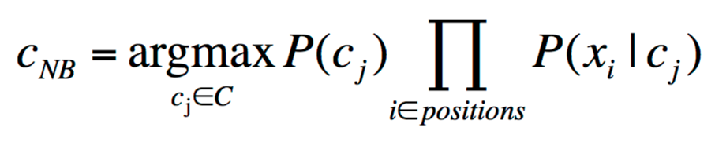
Text Classification Algorithms: Classifying
positions ← all word positions in current document which contain tokens found in Vocabulary
Return cNB, where

Slide 20
Naïve Bayes Posterior Probabilities
Classification results of naïve Bayes (the class with maximum posterior probability) are usually fairly accurate.
However, due to the inadequacy of the conditional independence assumption, the actual posterior-probability numerical estimates are not.
Output probabilities are generally very close to 0 or 1.

